Slide 1

Chapter 2
FINITE AUTOMATA

Slide 2

Learning Objectives At the conclusion of the chapter, the student will be able to:
Describe the components of a deterministic finite accepter (dfa)
State whether an input string is accepted by a dfa
Describe the language accepted by a dfa
Construct a dfa to accept a specific language
Show that a particular language is regular
Describe the differences between deterministic and nondeterministic finite automata (nfa)
State whether an input string is accepted by a nfa
Construct a nfa to accept a specific language
Transform an arbitrary nfa to an equivalent dfa

Slide 3
Deterministic Finite Accepters
Def 2.1: A deterministic finite accepter is defined by
Q: a finite set of internal states
Σ: a set of symbols called the input alphabet
δ: a transition function from Q X Σ to Q
q₀: the initial state
F: a subset of Q representing the final states
Example 2.1: Consider the dfa
Q = { q₀, q₁, q₂ } Σ = { 0, 1 } F = { q₁ }
where the transition function is given by
δ(q₀, 0) = q₀ δ(q₀, 1) = q₁ δ(q₁, 0) = q₀
δ(q₁, 1) = q₂ δ(q₂, 0) = q₂ δ(q₂, 1) = q₁

Slide 4
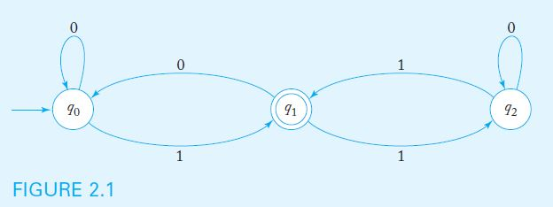
Transition Graphs
A DFA can be visualized with a Transition Graph
The graph below represents the dfa in Example 2.1:

Slide 5
Processing Input with a DFA
A DFA starts by processing the leftmost input symbol with its control in state q_{0.} The transition function determines the next state, based on current state and input symbol
The DFA continues processing input symbols until the end of the input string is reached
The input string is accepted if the automaton is in a final state after the last symbol is processed. Otherwise, the string is rejected.
For example, the dfa in example 2.1 accepts the string 111 but rejects the string 110

Slide 6
The Language Accepted by a DFA
For a given dfa, the extended transition function δ* accepts as input a dfa state and an input string. The value of the function is the state of the automaton after the string is processed.
Sample values of δ* for the dfa in example 2.1,
δ*(q₀, 1001) = q₁ δ*(q₁, 000) = q₀
The language accepted by a dfa M is the set of all strings accepted by M. More precisely, the set of all strings w such that δ*(q₀, w) results in a final state.

Slide 7
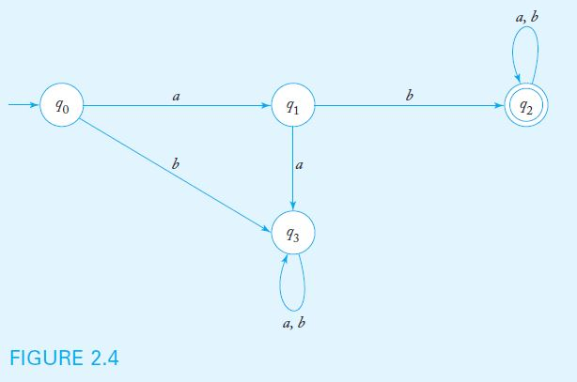
A Sample Deterministic Finite Accepter
Example 2.3 shows a dfa to accept the set of all strings on { a, b } that start with the prefix ab.

Slide 8
Regular Languages
Finite automata accept a family of languages collectively known as regular languages.
A language L is regular if and only if there is a DFA that accepts L. Therefore, to show that a language is regular, one must construct a DFA to accept it.
Practice: show that L = {(ab)^{n}a, n > 0} is regular.
Regular languages have wide applicability in problems that involve scanning input strings in search of specific patterns.

Slide 9
Nondeterministic Finite Accepters
An automaton is nondeterministic if it has a choice of actions for given conditions
Basic differences between deterministic and nondeterministic finite automata:
In an nfa, a (state, symbol) combination may lead to several states simultaneously
If a transition is labeled with the empty string as its input symbol, the nfa may change states without consuming input
an nfa may have undefined transitions

Slide 10
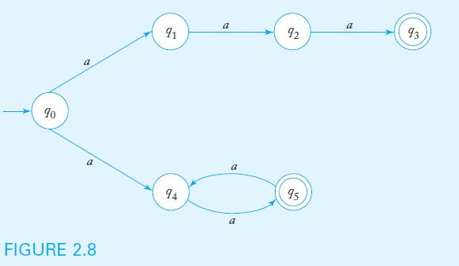
Nondeterministic FA Example 2.7
Example 2.7 shows a nondeterministic fa in which there are two transitions labeled a out of state q₀
More precisely, δ(q₀, a) = { q_{1,} q₄ }

Slide 11
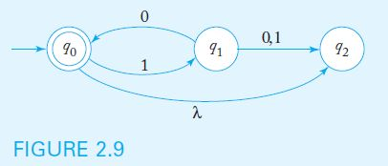
Nondeterministic FA Example 2.8
Example 2.8 shows a nondeterministic fa which contains both a λ-transition as well as undefined transitions
More precisely, δ(q₀, λ) = { q₂ } and δ(q₂, 0) = ∅

Slide 12
The Language Accepted by a Nondeterministic FA
For a given nfa, the value of the extended transition function δ*(q_{i}, w) is the set of all possible states for the control unit after processing w, having started in q_{i}
Sample values of δ* for the nfa in example 2.8:
δ*(q₀, 10) = { q₀, q₂ } δ*(q₀, 101) = { q₁ }
A string w is accepted if δ*(q₀, w) contains a final state. In the example above, 10 would be accepted but 101 would be rejected.
As is the case with dfa, the language accepted by a nondeterministic fa M is the set of all accepted strings. The machine in example 2.8 accepts L = { (10)^{n}: n ≥ 0 }

Slide 13
Equivalence of Deterministic and Nondeterministic Finite Accepters
Does nondeterminism make it possible to accept languages that deterministic fa cannot recognize?
As it turns out, per Theorem 2.2: For any nondeterministic finite accepter, there is an equivalent deterministic finite accepter
Therefore, every language accepted by a nondeterministic finite accepter is regular
To prove theorem 2.2, a constructive proof is given. The algorithm outlines the steps to follow when building a dfa equivalent to a particular nfa

Slide 14
Procedure: nfa-to-dfa Conversion
Beginning with the start state, define input transitions for the dfa as follows:
If the nfa input transition leads to a single state, replicate for the dfa
If the nfa input transition leads to more than one state, create a new state in the dfa labeled { q_{i}, ..., q_{j} }, where q_{i}, ..., q_{j} are all the states the nfa transition can lead to.
If the nfa input transition is not defined, the corresponding dfa transition should lead to a trap state.
Repeat step 1 for all newly created dfa states, until no new states are created.
Any dfa state containing an nfa final state in its label should be labeled as final.
If the nfa accepts the empty string, label the start dfa state a final state.

Slide 15
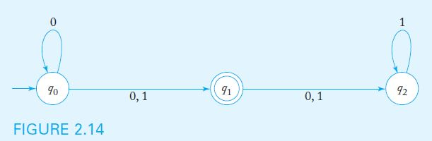
nfa-to-dfa Conversion Example
When applying the conversion procedure to the nfa below, we note the following nfa transitions
δ(q₀, 0) = { q₀, q₁ } δ(q₀, 1) = { q₁ }
δ(q₁, 0) = { q₂ } δ(q₁, 1) = { q₂ }
δ(q₂, 0) = ∅ δ(q₂, 1) = { q₂ }

Slide 16
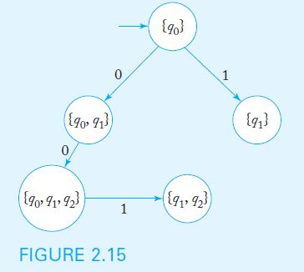
nfa-to-dfa Conversion Example (cont.)
We add transitions from q₀ to states { q₀, q₁ } and { q₁ }
Note that δ(q₀, 0) ∪ δ(q₁, 0) = { q₀, q₁, q₂ } and
δ(q₀, 1) ∪ δ(q₁, 1) ∪ δ(q₂, 1) = { q₁, q₂ }
So we add transitions to states { q₀, q₁, q₂ } and { q₁, q₂ }

Slide 17
nfa-to-dfa Conversion Example (cont.)
Note that δ(q₁, 0) ∪ δ(q₂, 0) = { q₂ } and
δ(q₁, 1) ∪ δ(q₂, 1) = { q₂ }
So we add 0-1 transitions from { q₁, q₂ } to { q₂ }
Similarly, we add 0-1 transitions from { q₁ } to { q₂ }
Since δ(q₂, 1) = { q₂ }, we add the corresponding transition
Since δ(q₂, 0) is undefined, we add a trap state (labeled ∅) as well as the corresponding transitions.

Slide 18
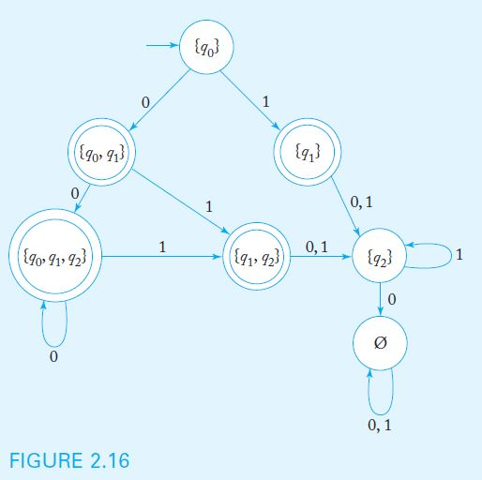
nfa-to-dfa Conversion Example (cont.)
Since there are no dfa states with undefined transitions, the process stops. All states containing q₁ in their label are designated as final states.

